Slide 1
Analyzing the Impact of the Pandemic: Movies & Streaming
Team Members:
Jamie Hutton
Perla Lampinstein
Stefan Kniejski
Jerrod Williams
Alexander Chavera

Slide 2
How the pandemic has affected the entertainment industry specifically between movie theaters and streaming services.
The pandemic has had an impact in every aspect of our lives. Behavioral changes shifted fast when the pandemic began, such as social distancing, masking and isolation from others. People stopped going to places where large crowds used to gather, an example for this are movie theaters. As people stayed home, the alternative for entertainment became obvious : Streaming services. Companies, such as Disney +, Hulu, Netflix, and HBO Max, provided the distraction from what was happening outside our homes.
As the restrictions stemming from the pandemic were lifted, people started going back out. With this analysis, we are trying to identify where the trend is going in the movie industry.
Are we going back to the movie theaters like in out pre-pandemic years? Or, are we staying home and taking advantage of what the streaming services keep offering?

Slide 3
The pandemic had and continues to have unknown but undeniable change on the lives we had prior. Though devastating, such a catastrophic event never seen before is full of extremely valuable information ripe for analysis.
This project will evaluate the impact of COVID-19 had with going to the movies and staying home to stream. Using data such as total ticket sales the group will analyze the reaction the pandemic had on the moviegoer experience.
The audience our data is intended for is primarily production companies, the movie theater marketing industry as well as analysts curious in the impact the Pandemic had. By knowing how the market is behaving, businesses will be able to make more insightful financial decisions with research to support it. By analyzing the impact of the pandemic, society as a whole can rebuild and be better prepared for the future.

Slide 4
Research questions
What was the box-office and streaming revenue before (pre-2020), during (2020-2021), and after (2022 – current) Covid-19?
Did Covid-19 lead to changes in audience preferences and viewing habits?
How did this affect the streaming industry?
Datasets to Be Used:
https://www.the-numbers.com/market/ - Stats on movie theaters
https://www.kaggle.com/datasets/ashukr/movie-rating-data - Stats on movie ratings i.e. Rotten Tomatoes
https://www.kaggle.com/datasets/ruchi798/movies-on-netflix-prime-video-hulu-and-disney - List of movies, info
https://covid19.who.int/region/amro/country/us - COVID-19 data

Slide 5
The emergence of COVID-19 and the following pandemic undoubtedly had massive impact to society as a whole but it had a particularly devastating effect on social behaviors.
Hypothesis
People will continue to favor streaming services over going to the movies. Ticket sales and revenue of movie theaters will not go back to its pre-pandemic days in the near future.
Null Hypothesis
People will go back to the movie theaters as it used to do before the pandemic leaving streaming services behind. Ticket sales and revenue of movie theaters will go back to its pre-pandemic days in the near future.

Slide 6
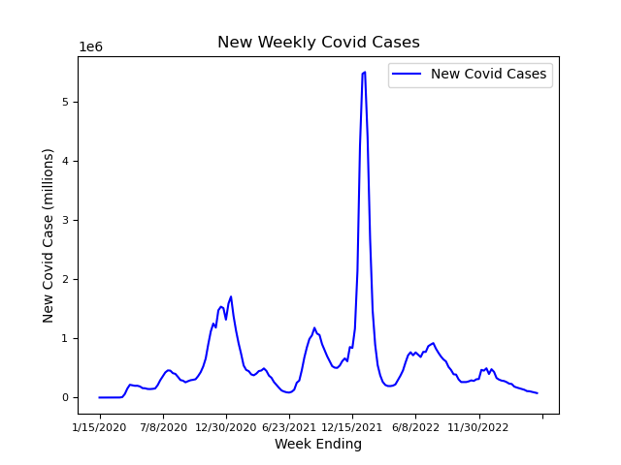
COVID-19 Cases in the United States
This graph shows the weekly cases of Covid-19 in the United States between January of 2020 to the end of March of 2023. We can see a spike in cases by the end of 2020 and again at the end of 2021.

Slide 7
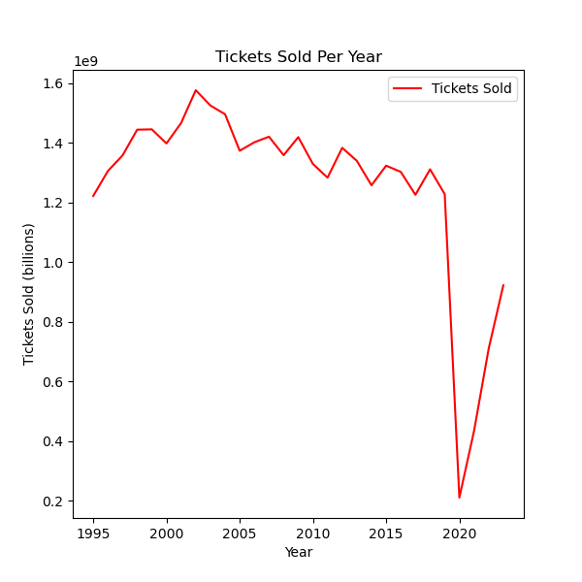
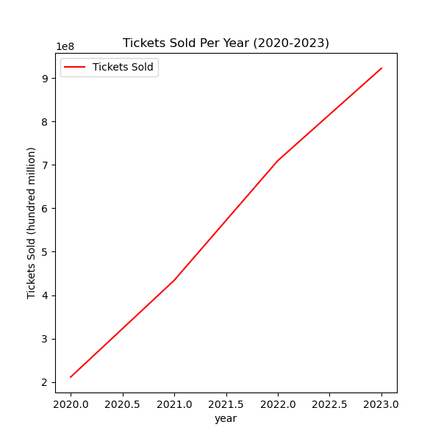
Tickets Sold Per Year Pre and Post Pandemic
On the graph on the left: we see tickets sold from 1995-2023. We see the number of tickets sold was above 1.2 billion and rose to as high as nearly 1.6 billion. Then when the pandemic hits, it drops to below 200 million. The graph on the right shows the number of tickets sold from the start of the pandemic to today. We see a consistent rise. Whether or not it returns to pre-pandemic numbers remains to be seen.

Slide 8
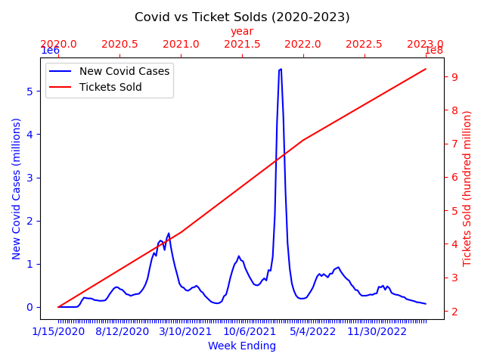
COVID-19 Cases in the United States
On this graph we can see more clearly the behavior of tickets sold (red line) vs the covid 19 cases (blue graph). Although there was a considerable drop on tickets sold at the beginning of the pandemic, people started going back to the movie theaters right after.

Slide 9
How did this affect the streaming industry?
The pandemic had a massive and immediate impact on streaming services. Contrary to the devastating damage the pandemic had on theater ticket revenue, it had a vastly positive effect on streaming as a whole by causing huge spikes in streaming numbers such as revenue and subscribers.
The following graph shows how the revenue grew during the pandemic. Since people were home, streaming services were one of the only ways of entertainment. Big blockbuster movies that were set to be released in theaters were released online instead.
Movies released throughout the pandemic, such as Godzilla vs. Kong, Black Widow, Raya and the Last Dragon and A Quiet Place II, were all available on streaming services rather than at in-person theaters(1).
:https://eagleeye.news/23311/feature/movie-theaters-become-popular-again-after-covid-19/#:~:text=Movies%20released%20throughout%20the%20pandemic,than%20at%20in%2Dperson%20theaters.

Slide 10
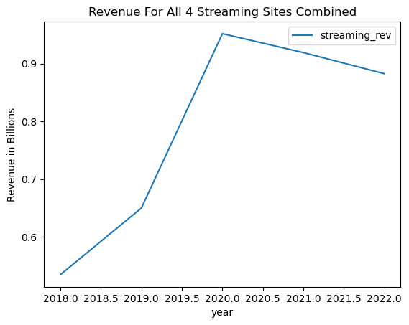
Streaming Sites Revenue
Here, we have all four streaming sites revenue combined; Netflix, HBO Max, Disney+ and Hulu. We see a sharp rise when the pandemic started roughly peaking at around 1 billion. From there, after theaters started opening back up, it starts to come back down slightly but at a very slow rate.

Slide 11
Did Covid lead to changes in audience preferences and viewing habits?
The COVID-19 pandemic had incredible influence on a lot of aspects in our daily lives. One of those things was preferences, viewing habits and behaviors. As social restrictions were lifted, it is shown that the vast populace still preferred to be in solitude, with most preferring to watch new releases at home.
The following graph shows a comparison between the subscribers among the 4 major streaming services (Netflix, Disney Plus, Hulu and HBO Max), and the tickets sold in theaters in the United States.
We can see how even though the tickets sales are going up after the pandemic, they are still less that the number of subscribers on the two major streaming platforms (Netflix and Disney Plus), while Hulu and HBO if not gaining more viewers, are not losing any either.

Slide 12
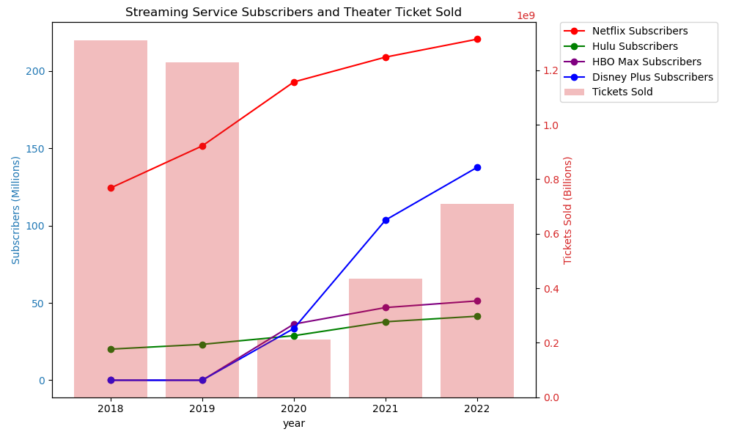

Slide 13
What was the revenue before (pre-2020), during (2020-2021), and after (2022 – current) Covid?
The data shows a drop in revenue for movie theaters during the pandemic, and a steady but slow growth in the years after. During these years, the industry only reported a fraction of proceeds from previous years. However, streaming service subscribers kept going up.
The following chart shows this relationship.

Slide 14
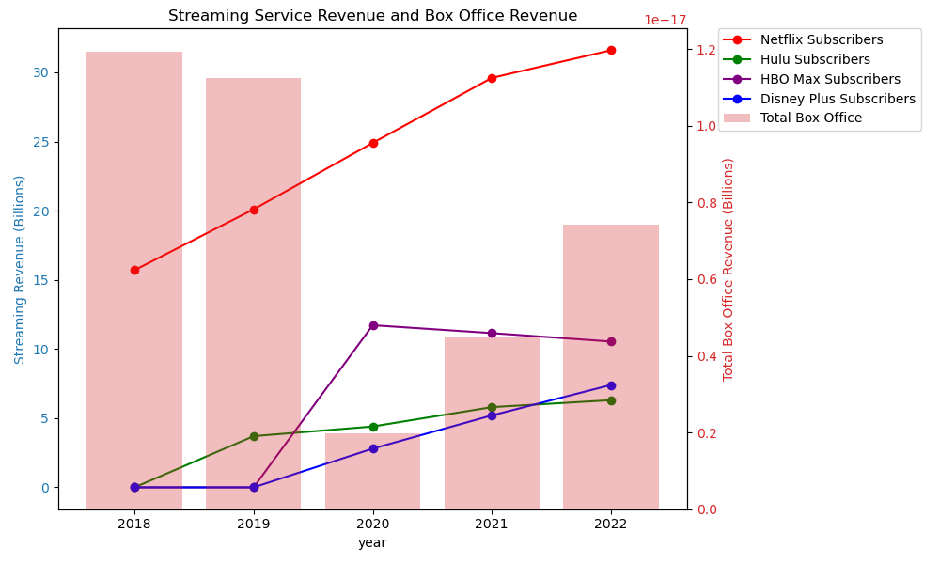

Slide 15
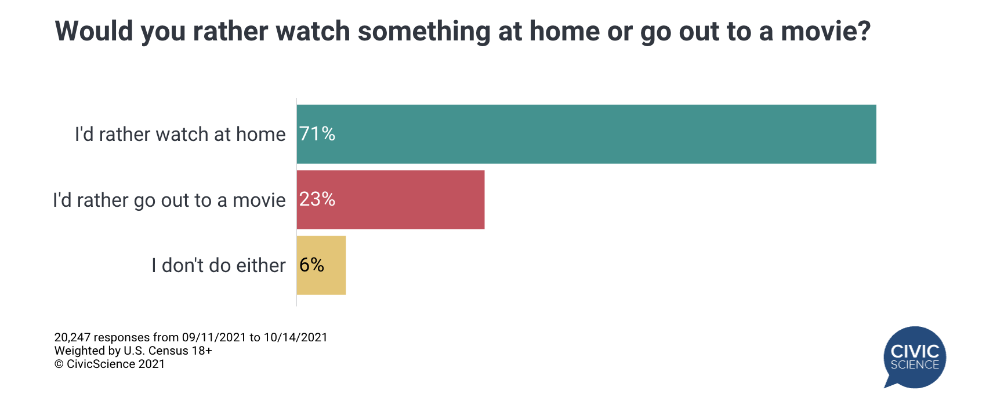
According to a survey by Civic Science at the end of 2021, 71% out of a total of 20,247 people interviewed would rather stay at home then go out to a movie.

Slide 16
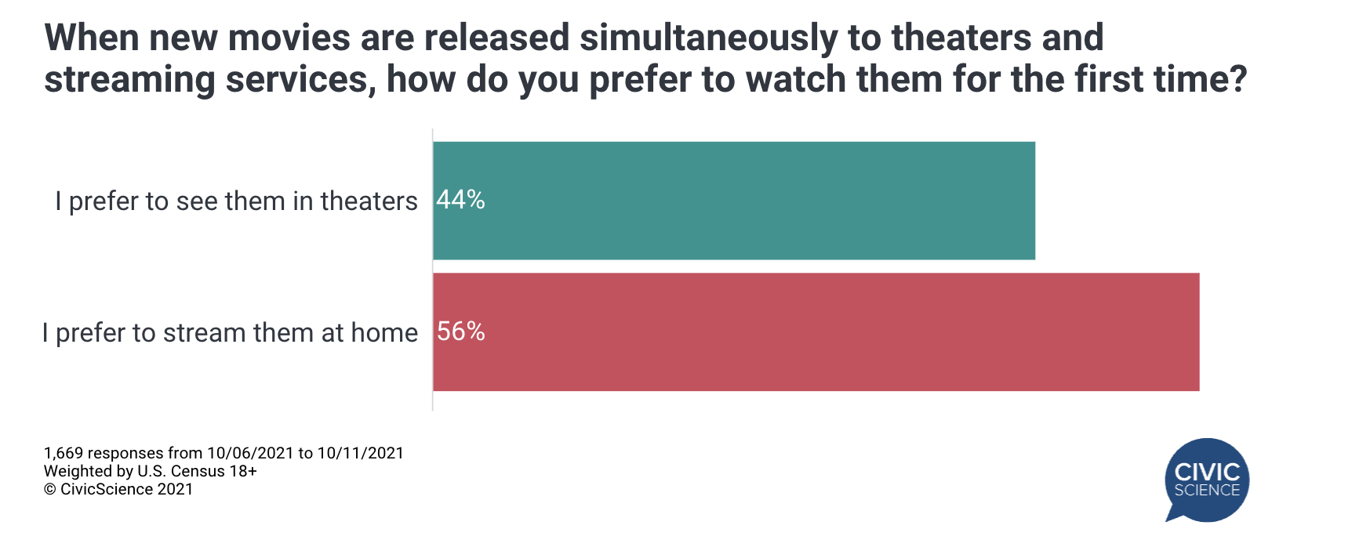
When prompted about where would they prefer to see a movie that is released in both theaters and streaming services, the majority of people choose to stay at home.

Slide 17
Conclusion
In conclusion, we can confidently say the pandemic caused by Covid-19 had a lasting impact in preferences and opinions around the United States.
As the data reveals, people have continued to favor streaming services over going to the movies. Three years after the pandemic, ticket sales and revenue of movie theaters haven’t gone back to its pre-pandemic days. Even though ticket sales and revenue is trending upward, we can see people are continuing to lean on the convenience of streaming services.
The data provides strong evidence that some changes brought on following the pandemic, primarily caused by the vast restrictions on daily life it came with, may be permanent. Movie theaters may have a future up in the air while streaming, as a whole, will continue to expand exponentially.

